Slide 1
Disclaimer/s
We hope you find the information on our website and resources useful.
Animations
This resource has been designed with animations to make it as fun and engaging as possible. To view the content in the correct formatting, please view the PowerPoint in ‘slide show mode’. This takes you from desktop to presentation mode. If you view the slides out of ‘slide show mode’, you may find that some of the text and images overlap each other and/or are difficult to read.
To enter slide show mode, go to the slide show menu tab and select either from beginning or from current slide.
You may wish to delete this slide before beginning the presentation.

Slide 3
What Is Symmetry?
Something is symmetrical when it is the same on both sides.
Everything around us is either symmetrical or asymmetrical.
Asymmetrical objects or shapes are not the same on both sides.

Slide 4

Symmetry
In Maths, we learn about symmetry.

Slide 5
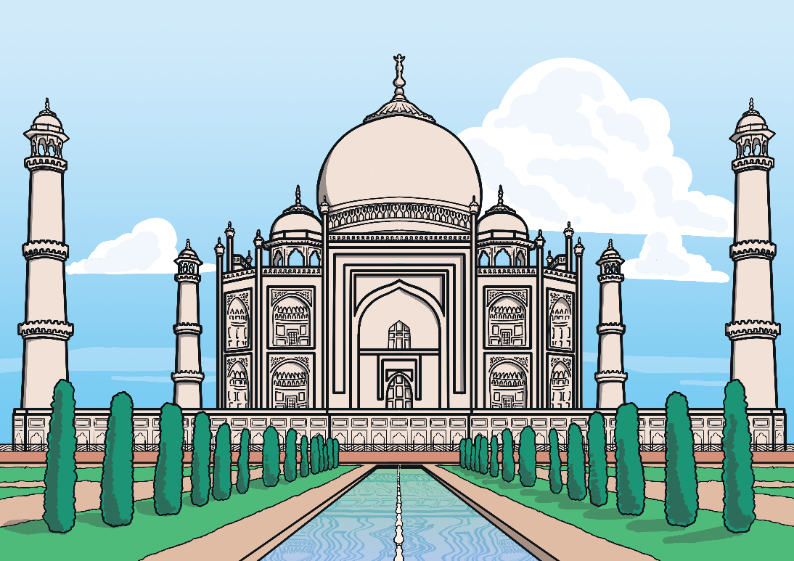
Symmetry
Symmetry often comes up in Art and Design activities too.

Slide 6


Butterflies
Some of us may know that butterflies are symmetrical creatures.
If butterflies were folded in half, they would have the same shape and pattern on both sides. Butterflies have 1 line of symmetry.

Slide 7


How Can You Find Out If a Shape Is Symmetrical?
There are two ways of finding out if a shape is symmetrical.
The first way is to draw the shape and fold it in half. Are they the same on both sides when you unfold them?
S

Slide 8
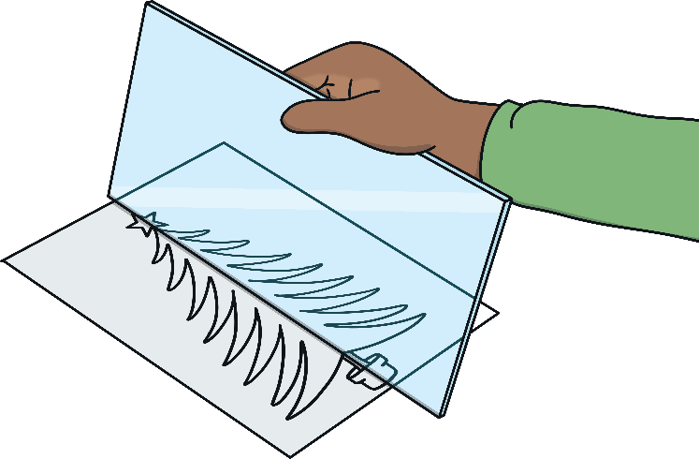
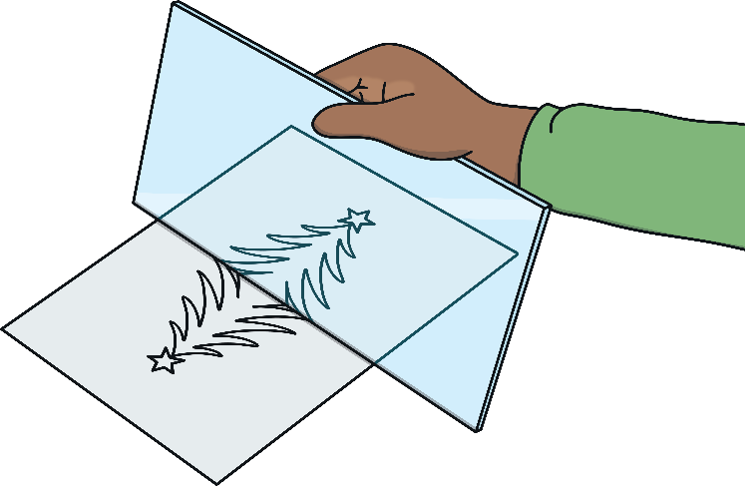
How Can You Find Out If a Shape Is Symmetrical?
The other way you can find out if a shape is symmetrical is by using a mirror.
If you hold the mirror up along the middle of a shape, you can see by looking in the mirror if the shape is exactly the same on the other side.

Slide 9


Shapes with One Line of Symmetry
This is an isosceles triangle.
This type of triangle has 1 line of symmetry down the centre. If you try and fold it in other ways, it won’t be the same on both sides.

Slide 10

Shapes with More Than One Line of Symmetry
This is a rectangle. It has 2 lines of symmetry.

Slide 11

Shapes with More Than One Line of Symmetry
This is a square. A square has 4 lines of symmetry.

Slide 12

Shapes with No Lines of Symmetry
Many irregular shapes have no lines of symmetry. An irregular shape is a shape whose sides are not the same.

Slide 13
Do You Think the Following Shapes Have Lines of Symmetry?
Circles have an infinite number of lines of symmetry. As long as the line passes through the centre of the circle, it will be a line of symmetry.

Slide 14
Do You Think the Following Shapes Have Lines of Symmetry?
This arrow has 1 line of symmetry down the middle.

Slide 15
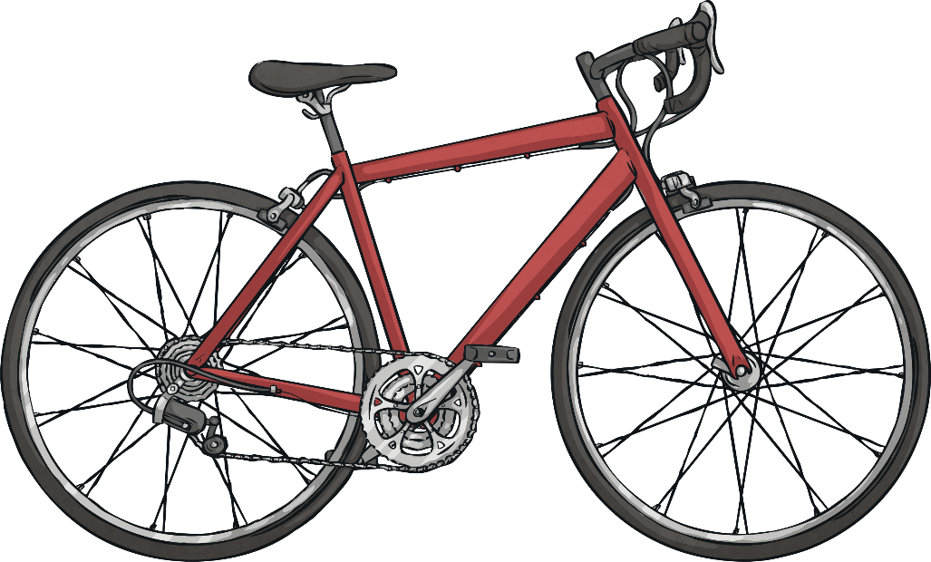
Do You Think the Following Shapes Have Lines of Symmetry?
This bicycle has no lines of symmetry. It is not the same on both sides.

Slide 16
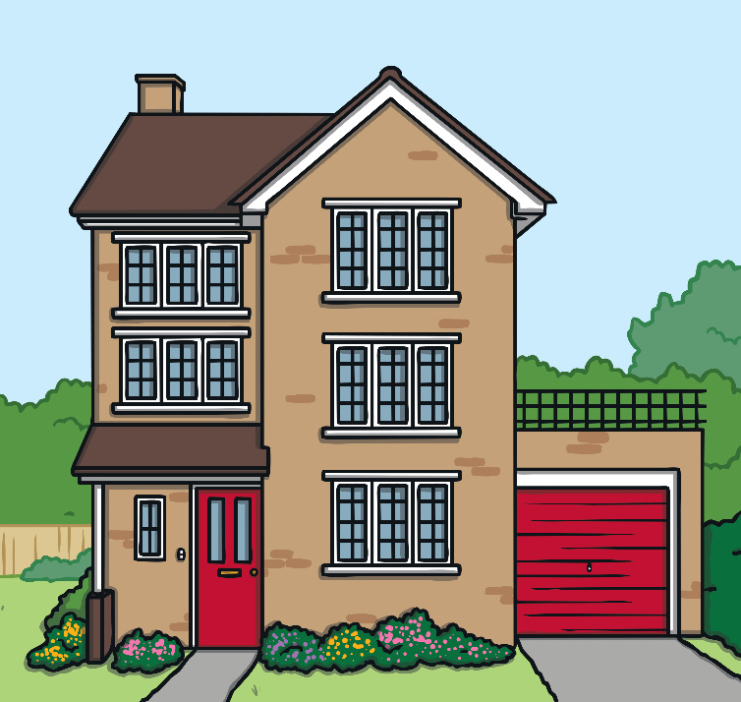
Do You Think the Following Shapes Have Lines of Symmetry?
This shape does not have any lines of symmetry.
It is not the same on both sides.

Slide 17

Do You Think the Following Shapes Have Lines of Symmetry?
This shape has 1 line of symmetry down the middle.

Slide 18

Challenge!
Can you draw some shapes, cut them out and fold them in different places to see if they have any lines of symmetry?

